Slide 1
Award for Technical Excellence FY2019 Final CTO Review
Artie Kalemeris & David Stevens

Slide 2
The Award
Given each year for outstanding achievements in delivered client solutions
One award may be given in each of six categories
Team members receive the award. Up to FOUR people may be included on a team.
Awards are selected based on excellence in technology, execution and results
Complete program description at https://my.dxc.com/our-company/global-functions/technology-office/dxc-awards-for-technical-excellence-.html

Slide 3
Award Process
Open window for field to submit solutions to Digital Explorer
Regional CTOs each nominate one solution from their region in each category
Offering, Industry and Delivery CTOs rate the nominations
Global CTO presents recommended awards to Decision Committee
Decision Committee/CEO confirm final awards and announcement to winners
September 1st ~ 17th
October 1st
October 10th
October 15th
December
WE ARE HERE

Slide 4
FY2019 Award Schedule
September 1 – 17 | Field submits solutions to Digital Explorer
October 1 | Regional CTO nominations due
October 10 | Industry, Offering, Delivery CTO reviews complete
October 15 | Global CTO presents recommended winners to Decision Committee
December | Winners Notified

Slide 5
Award Selection Criteria
Technology Excellence
The deep technology acumen, domain knowledge and product expertise the team applied to create a world-class solution for the client that demonstrates a key transformational shift(s) and moves the client along its digital transformation journey. The high levels of design, development, integration and leverage of open and/or next-gen technologies the team demonstrated.
Execution Excellence
The technological and process-driven precision the team applied, including timeliness and cost-effectiveness.
Results
The meaningful value for the client and DXC Technology that resulted from the team’s work. This could be a new core capability, an innovation, significant savings, or new use for a solution from our portfolio.
Solutions must be delivered to the client. Internal projects are not eligible.

Slide 6
Recommendations
Category | Reviewers | Selection (click to view)
Agile Applications and Digital Experiences | JP Morgenthal
Enabling the Enterprise Through Hybrid Cloud | Jim Miller | Hybrid Cloud High Performance Computing (HPC)
Empowering Workforces with Invisible IT | Marc Wilkinson
Thriving on Enterprise Data and Analytics | Dragan Rakovich | Daimler IT for Autonomous Driving (IT4AD)
Managing Enterprise Risk in a Connected World | Chris Moyer Ed Reynolds
Industry Specific Transformation | Femi Ladega Brian Wallace Kavi Pelpola Neil Fagan

Slide 7
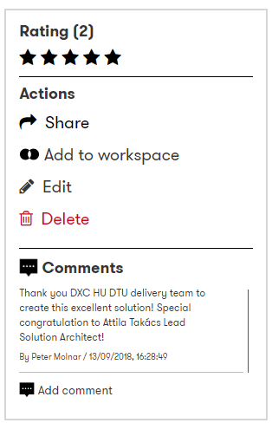
Rate and comment within Digital Explorer
As you review the solution within Digital Explorer, you have the option to use the ratings and comments option to provide direct feedback for the solution owners and also others who view the datasheet later.
Note : These comments are visible to anyone within DXC
@Dan please leave a comment at the time of the announcement against each winning solution

Slide 8
Regional Selections

Slide 9
Agile Applications and Digital Experiences
Solution Name | Region | Account | DE Link | Review Outcome
Digital Transformation - Crew Training Instructor Self Scheduling Responsive Web Application | America | American Airlines | Ctrl-Click to view
India Post Bank Countrywide Banking Solution | Asia | India Post Bank | Ctrl-Click to view
XR (Mixed Reality) Forensics | ANZ | Government law enforcement agency | Ctrl-Click to view
DTU set up and Agile and DevOps project solution | N & C Europe | Zurich EMEA | Ctrl-Click to view
 | S Europe
 | UKIIMEA
Place an “X” in the review outcome column for your chosen solution
Only 1 selection per category

Slide 10
Enabling the Enterprise Through Hybrid Cloud
Solution Name | Region | Account | DE Link | Review Outcome
 | America
- | Asia | - | - | -
- | ANZ | - | - | -
DXC Composer | N & C Europe | - | Ctrl-Click to view
DXC Lambda | S Europe | Flemish Government | Ctrl-Click to view
 | UKIIMEA
Place an “X” in the review outcome column for your chosen solution
Only 1 selection per category

Slide 11
Empowering Workforces with Invisible IT
Solution Name | Region | Account | DE Link | Review Outcome
- | America | - | - | -
- | Asia | - | - | -
- | ANZ | - | - | -
DXC Medical Coding | N & C Europe |  | Ctrl-Click to view
- | S Europe | - | - | -
 | UKIIMEA
Place an “X” in the review outcome column for your chosen solution
Only 1 selection per category

Slide 12
Thriving on Enterprise Data and Analytics
Solution Name | Region | Account | DE Link | Review Outcome
EMMA - Enhanced Machine learning & Multilayered Analytics for P&G | America | P&G | Ctrl-Click to view
- | Asia | - | - | -
- | ANZ | - | - | -
Daimler IT for Autonomous Driving (IT4AD) | N & C Europe | Daimler AG | Ctrl-Click to view
Using data analytics to make roads safer | S Europe | Flemish Government | Ctrl-Click to view
 | UKIIMEA
Place an “X” in the review outcome column for your chosen solution
Only 1 selection per category

Slide 13
Managing Enterprise Risk in a Connected World
Solution Name | Region | Account | DE Link | Review Outcome
AppFit (“Application Fitness”) | America | P&G | Ctrl-Click to view
Firewall Rules Strategy & Improvement | Asia | DXC (VPC) | Ctrl-Click to view
Smart AR Energy | ANZ | Essential Energy | Ctrl-Click to view
Security patching and reporting automation using DXC Standard Toolset (BigFix) | N & C Europe | General Electric Company | Ctrl-Click to view
- | S Europe | - | - | -
 | UKIIMEA
Place an “X” in the review outcome column for your chosen solution
Only 1 selection per category

Slide 14
Industry Specific Transformation
Solution Name | Region | Account | DE Link | Review Outcome
Quote Generation with smart speakers | America | Farmers (Zurich) | Ctrl-Click to view
ePOS - Electronic Point of Sales for Insurance | Asia | Manulife | Ctrl-Click to view
Marksmanship application | ANZ | Armed Forces | Ctrl-Click to view
CSAVAR | N & C Europe | Magyar Telekom Deutsche Telekom | Ctrl-Click to view
- | S Europe | - | - | -
 | UKIIMEA
Place an “X” in the review outcome column for your chosen solution
Only 1 selection per category

Slide 15
All Submissions

Slide 16
List of submissions – AMS (1)
Solution Name | Account | Category | Direct Link
AppFit (“Application Fitness”) | P&G | Managing Enterprise Risk | Direct Link
Automated Backup Status and Configuration Reporting | General Electric Company | Agile Applications and Digital Experiences | Direct Link
 |  | Enterprise Data and Analytics
Backup Data Center Consolidation | Zurich | Hybrid Cloud Platform | Direct Link
Cognitive Claims Straight-Through Processing Solution | Zurich | Agile Applications and Digital Experiences | Direct Link
 |  | Industry-Specific Transformation
Digital Transformation - Crew Training Instructor Self Scheduling Responsive Web Application | American Airlines | Agile Applications and Digital Experiences | Direct Link
Downgrade and Restore MS SQL Server Enterprise Featured Legacy Application Database to Standard Edition of Same Version or Higher | National Grid | Enterprise Data and Analytics | Direct Link
 |  | Industry-Specific Transformation
EMMA - Enhanced Machine learning & Multilayered Analytics for P&G | P&G | Enterprise Data and Analytics | Direct Link
Hybrid Cloud High Performance Computing (HPC) | United Technologies Corporation | Hybrid Cloud Platform | Direct Link
Managed Services for Microsoft Azure - CloudOps | CIBC | Agile Applications and Digital Experiences | Direct Link
 |  | Hybrid Cloud Platform
Notes:
match (s:Solution)--(t:Tag {name:'Technical Excellence 2019'})
optional match (s)--(si:SubIndustry)--(i:Industry)
optional match (s)--(r:Region)
optional match (s)--(a:Account)
optional match (s)--(c:Category)
return DISTINCT s.name as Name ,s.elevatorPitch as ElevatorPitch, c.name as Category, id(s) as SolutionID, s.createdBy as CreatedBy,r.name as Region,a.name as Account, i.name as Industry

Slide 17
List of submissions – AMS (2)
Solution Name | Account | Category | Direct Link
MMIS Healthcare Localization English & Spanish for Puerto Rico DDI | None given | Industry-Specific Transformation | Direct Link
Modernize Legacy COBOL system to Java Spring | California Dept. of Social Services | Agile Applications and Digital Experiences | Direct Link
 |  | Hybrid Cloud Platform
My_Enterprise_Portal | None given | Digital Workplace Transformation | Direct Link
Plant IT Virtual Platform Automation | P&G | Agile Applications and Digital Experiences | Direct Link
Quote Generation with smart speakers | Farmers (Zurich) | Industry-Specific Transformation | Direct Link
Reinsurance on the Blockchain with permissioned ledger | Farmers (Zurich) | Industry-Specific Transformation | Direct Link
Social Services Program - Advanced Data and Analytics Capabilities | California Dept. of Social Services | Enterprise Data and Analytics | Direct Link
Tops Markets IT Transformation | Tops markets | Hybrid Cloud Platform | Direct Link
 |  | Industry-Specific Transformation
 |  | Digital Workplace Transformation
Notes:
match (s:Solution)--(t:Tag {name:'Technical Excellence 2019'})
optional match (s)--(si:SubIndustry)--(i:Industry)
optional match (s)--(r:Region)
optional match (s)--(a:Account)
optional match (s)--(c:Category)
return DISTINCT s.name as Name ,s.elevatorPitch as ElevatorPitch, c.name as Category, id(s) as SolutionID, s.createdBy as CreatedBy,r.name as Region,a.name as Account, i.name as Industry

Slide 18
List of submissions - ANZ
Solution Name | Account | Category | Direct Link
Automated Backup Status and Configuration Reporting | General Electric Company | Agile Applications and Digital Experiences | Direct Link
 |  | Enterprise Data and Analytics
Essential Energy Smart AR Checklist | None given | Agile Applications and Digital Experiences | Direct Link
 |  | Enterprise Data and Analytics
Marksmanship application | None given | Agile Applications and Digital Experiences | Direct Link
React Blockchain Demo | None given | Agile Applications and Digital Experiences | Direct Link
XR (Mixed Reality) Forensics | None given | Agile Applications and Digital Experiences | Direct Link
 |  | Enterprise Data and Analytics
Notes:
match (s:Solution)--(t:Tag {name:'Technical Excellence 2019'})
optional match (s)--(si:SubIndustry)--(i:Industry)
optional match (s)--(r:Region)
optional match (s)--(a:Account)
optional match (s)--(c:Category)
return DISTINCT s.name as Name ,s.elevatorPitch as ElevatorPirch,r.name as Region ,a.name as Account, i.name as Industry, c.name as Category, id(s) as SolutionID, s.createdBy as CreatedBy

Slide 19
List of submissions - ASIA
Solution Name | Account | Category | Direct Link
Automated Backup Status and Configuration Reporting | General Electric Company | Agile Applications and Digital Experiences | Direct Link
 |  | Enterprise Data and Analytics
Digital Warehouse Personnel Health Evaluation system. | None given | Industry-Specific Transformation | Direct Link
Downgrade and Restore MS SQL Server Enterprise Featured Legacy Application Database to Standard Edition of Same Version or Higher | National Grid | Enterprise Data and Analytics | Direct Link
 |  | Industry-Specific Transformation
India Post Bank Countrywide Banking Solution | India Post | Agile Applications and Digital Experiences | Direct Link
ePOS - Electronic Point of Sales for Insurance | Manulife | Agile Applications and Digital Experiences | Direct Link
Firewall Rules Strategy & Improvement | None given | Managing Enterprise Risk | Direct Link
 |  | Agile Applications and Digital Experience
Notes:
match (s:Solution)--(t:Tag {name:'Technical Excellence 2019'})
optional match (s)--(si:SubIndustry)--(i:Industry)
optional match (s)--(r:Region)
optional match (s)--(a:Account)
optional match (s)--(c:Category)
return DISTINCT s.name as Name ,s.elevatorPitch as ElevatorPirch,r.name as Region ,a.name as Account, i.name as Industry, c.name as Category, id(s) as SolutionID, s.createdBy as CreatedBy

Slide 20
List of submissions – N & C Europe (1)
Solution Name | Account | Category | Direct Link
BASF Transformation from Traditional to Digital IT for Chemical Industry | BASF | Hybrid Cloud Platform | Direct Link
 |  | Industry-Specific Transformation | Direct Link
Creation of an image of organizational structure | None given | Enterprise Data and Analytics | Direct Link
CSAVAR | None given | Agile Applications and Digital Experiences | Direct Link
 |  | Industry-Specific Transformation | Direct Link
Daimler Price List | Daimler | Agile Applications and Digital Experiences | Direct Link
 |  | Digital Workplace Transformation | Direct Link
DevOps Integration for build & test phases of Zurich DE Life applications - Versicherungs Mathematisches Subsystem (VMS) | Zurich EMEA | Agile Applications and Digital Experiences | Direct Link
DMS (Document Management System) | None given | null | Direct Link
DTU set up and Agile and DevOps project solution | Zurich EMEA | Agile Applications and Digital Experiences | Direct Link
Dubai Analytics Smart City Platform | Dubai Smart City | null | Direct Link
DXC DevOps Composer | None given | Agile Applications and Digital Experiences | Direct Link
 |  | Hybrid Cloud Platform | Direct Link
Notes:
match (s:Solution)--(t:Tag {name:'Technical Excellence 2019'})
optional match (s)--(si:SubIndustry)--(i:Industry)
optional match (s)--(r:Region)
optional match (s)--(a:Account)
optional match (s)--(c:Category)
return DISTINCT s.name as Name ,s.elevatorPitch as ElevatorPirch,r.name as Region ,a.name as Account, i.name as Industry, c.name as Category, id(s) as SolutionID, s.createdBy as CreatedBy

Slide 21
List of submissions – N & C Europe (2)
Solution Name | Account | Category | Direct Link
DXC Medical Coding | None given | Enterprise Data and Analytics | Direct Link
 |  | Digital Workplace Transformation
Emergency Management System for Earthquakes | None given | Agile Applications and Digital Experiences | Direct Link
 |  | Industry-Specific Transformation
GVF (Global Vehicle File) | None given | Agile Applications and Digital Experiences | Direct Link
Kubernetes instant deploy - fully automated container platform deployment | None given | Agile Applications and Digital Experiences | Direct Link
 |  | Hybrid Cloud Platform
OneDrive migration project | None given | Digital Workplace Transformation | Direct Link
Package Automation Tool | None given | Agile Applications and Digital Experiences | Direct Link
Security patching and reporting automation using DXC Standard Toolset (BigFix) | General Electric Company | Agile Applications and Digital Experiences | Direct Link
 |  | Managing Enterprise Risk
State of the Region (SOTR) | None given | Managing Enterprise Risk | Direct Link
 |  | Digital Workplace Transformation
Notes:
match (s:Solution)--(t:Tag {name:'Technical Excellence 2019'})
optional match (s)--(si:SubIndustry)--(i:Industry)
optional match (s)--(r:Region)
optional match (s)--(a:Account)
optional match (s)--(c:Category)
return DISTINCT s.name as Name ,s.elevatorPitch as ElevatorPirch,r.name as Region ,a.name as Account, i.name as Industry, c.name as Category, id(s) as SolutionID, s.createdBy as CreatedBy

Slide 22
List of submissions – N & C Europe (3)
Solution Name | Account | Category | Direct Link
STILL neXXt Fleet Management | KION Group AG | Agile Applications and Digital Experiences | Direct Link
 |  | Enterprise Data and Analytics
TITR | None Given | Agile Applications and Digital Experiences | Direct Link
 |  | Enterprise Data and Analytics
Cloud based logistics path assembly | None given | Agile Applications and Digital Experiences | Direct Link
Notes:
match (s:Solution)--(t:Tag {name:'Technical Excellence 2019'})
optional match (s)--(si:SubIndustry)--(i:Industry)
optional match (s)--(r:Region)
optional match (s)--(a:Account)
optional match (s)--(c:Category)
return DISTINCT s.name as Name ,s.elevatorPitch as ElevatorPirch,r.name as Region ,a.name as Account, i.name as Industry, c.name as Category, id(s) as SolutionID, s.createdBy as CreatedBy

Slide 23
List of submissions – S Europe
Solution Name | Account | Category | Direct Link
DBaaS configuration in Oracle SuperCluster | Zurich EMEA | Enterprise Data and Analytics | Direct Link
Digital Government Experience Center (DGX) | None given | Agile Applications and Digital Experiences | Direct Link
 |  | Enterprise Data and Analytics
 |  | Managing Enterprise Risk
 |  | Hybrid Cloud Platform
 |  | Industry-Specific Transformation
 |  | Digital Workplace Transformation
DTU set up and Agile and DevOps project solution | Zurich EMEA | Agile Applications and Digital Experiences | Direct Link
DXC Lambda | Flemish Government | Agile Applications and Digital Experiences | Direct Link
 |  | Hybrid Cloud Platform
Hybrid IT Operation and Application devlopement considerations | None given | Hybrid Cloud Platform | Direct Link
Open (Government) Data Strategy & Operations | Flemish Government | Agile Applications and Digital Experiences | Direct Link
Serverless AWS Event Monitoring | None given | Hybrid Cloud Platform | Direct Link
The DGX Design Studio Workshop: Accelerate innovation through interactive co-creation and concept prototyping | None given | Agile Applications and Digital Experiences | Direct Link
Using data analytics to make roads safer | Flemish Government | Enterprise Data and Analytics | Direct Link
Notes:
match (s:Solution)--(t:Tag {name:'Technical Excellence 2019'})
optional match (s)--(si:SubIndustry)--(i:Industry)
optional match (s)--(r:Region)
optional match (s)--(a:Account)
optional match (s)--(c:Category)
return DISTINCT s.name as Name ,s.elevatorPitch as ElevatorPirch,r.name as Region ,a.name as Account, i.name as Industry, c.name as Category, id(s) as SolutionID, s.createdBy as CreatedBy

Slide 24
List of submissions – UKIIMEA (1)
Solution Name | Account | Category | Direct Link
Digital Innovation Platform | None given | Hybrid Cloud Platform | Direct Link
Downgrade and Restore MS SQL Server Enterprise Featured Legacy Application Database to Standard Edition of Same Version or Higher | National Grid | Enterprise Data and Analytics | Direct Link
 |  | Industry-Specific Transformation
Mobile solution for supporting Urgent Care | None given | Digital Workplace Transformation | Direct Link
My_Enterprise_Portal | None given | Digital Workplace Transformation | Direct Link
National Grid Separation | National Grid | Hybrid Cloud Platform | Direct Link
Personas | None given | Agile Applications and Digital Experiences | Direct Link
 |  | Industry-Specific Transformation
Notes:
match (s:Solution)--(t:Tag {name:'Technical Excellence 2019'})
optional match (s)--(si:SubIndustry)--(i:Industry)
optional match (s)--(r:Region)
optional match (s)--(a:Account)
optional match (s)--(c:Category)
return DISTINCT s.name as Name ,s.elevatorPitch as ElevatorPirch,r.name as Region ,a.name as Account, i.name as Industry, c.name as Category, id(s) as SolutionID, s.createdBy as CreatedBy

Slide 25
List of submissions – UKIIMEA (2)
Solution Name | Account | Category | Direct Link
Smart Factory - Internet of Things (IoT) | None given | Agile Applications and Digital Experiences | Direct Link
 |  | Enterprise Data and Analytics
 |  | Industry-Specific Transformation
 |  | Digital Workplace Transformation
IoT supply chain management | Seadrill Management Ltd | Digital Workplace Transformation | Direct Link
NDC Bulgaria | Royal Bank of Scotland | Agile Applications and Digital Experiences | Direct Link
Automated Notification Service | None given | Agile Applications and Digital Experiences | Direct Link
Bare-Metal to fully deployed Factory | None given | Industry-Specific Transformation | Direct Link
Email to Ticket | None given | Digital Workplace Transformation | Direct Link
Notes:
match (s:Solution)--(t:Tag {name:'Technical Excellence 2019'})
optional match (s)--(si:SubIndustry)--(i:Industry)
optional match (s)--(r:Region)
optional match (s)--(a:Account)
optional match (s)--(c:Category)
return DISTINCT s.name as Name ,s.elevatorPitch as ElevatorPirch,r.name as Region ,a.name as Account, i.name as Industry, c.name as Category, id(s) as SolutionID, s.createdBy as CreatedBy

Slide 26
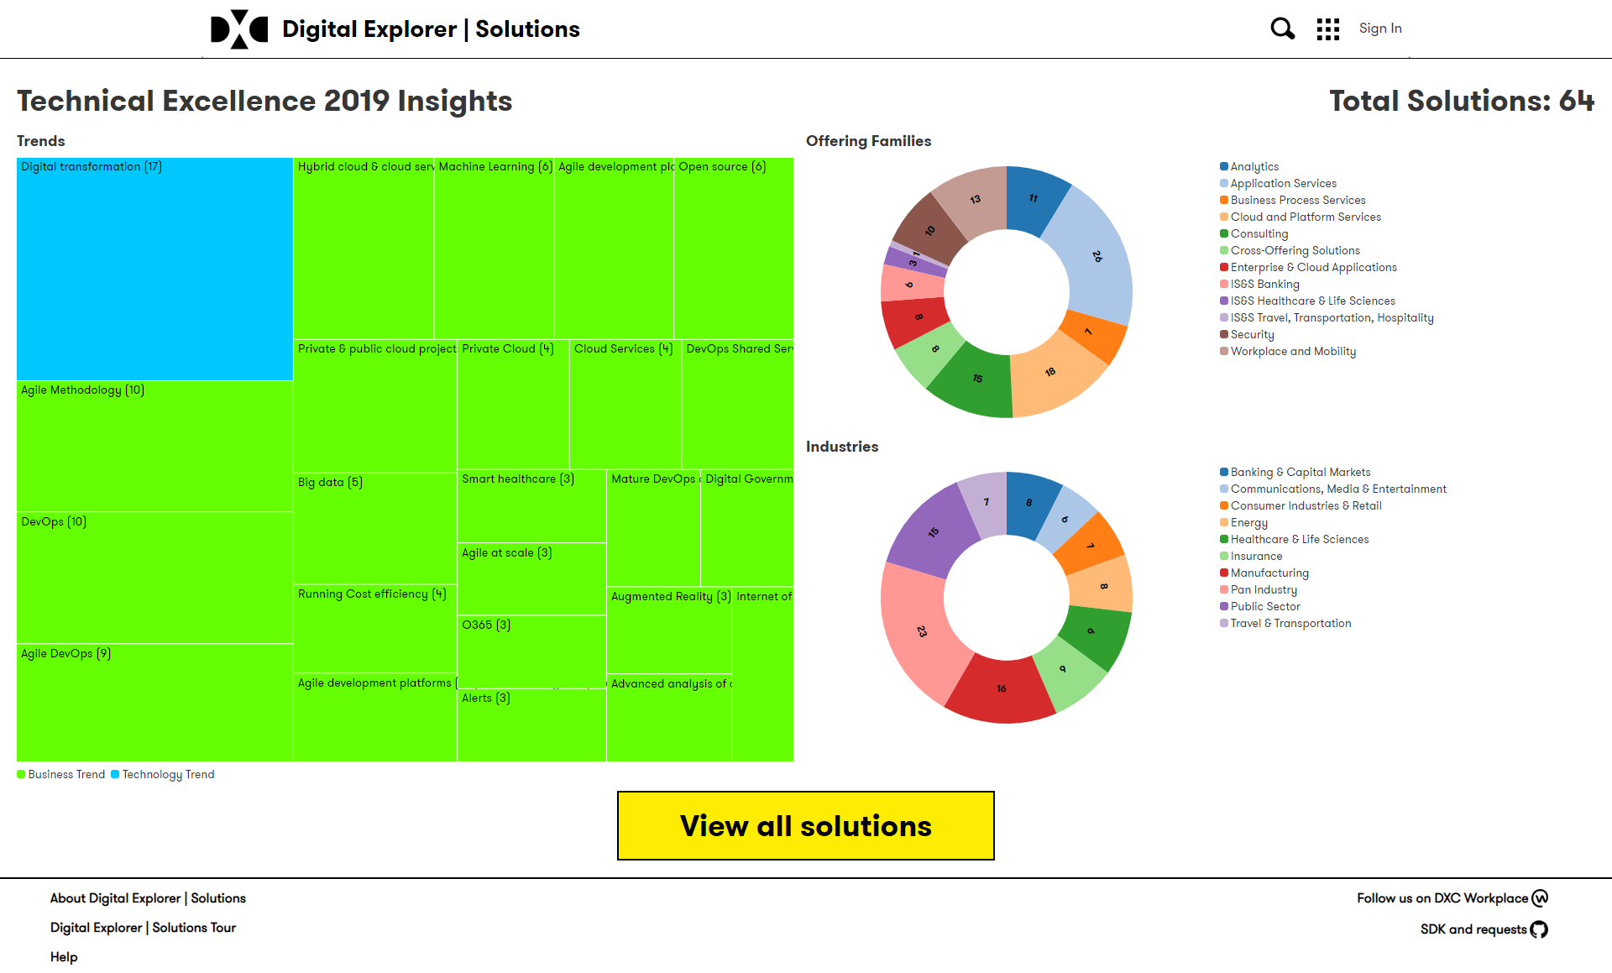
https://digitalexplorer.dxc.com/se/techexcellence/dashboard

